Slide 1

Introduction to Machine Learning
A Practical Example:
News Article Classification

Slide 2
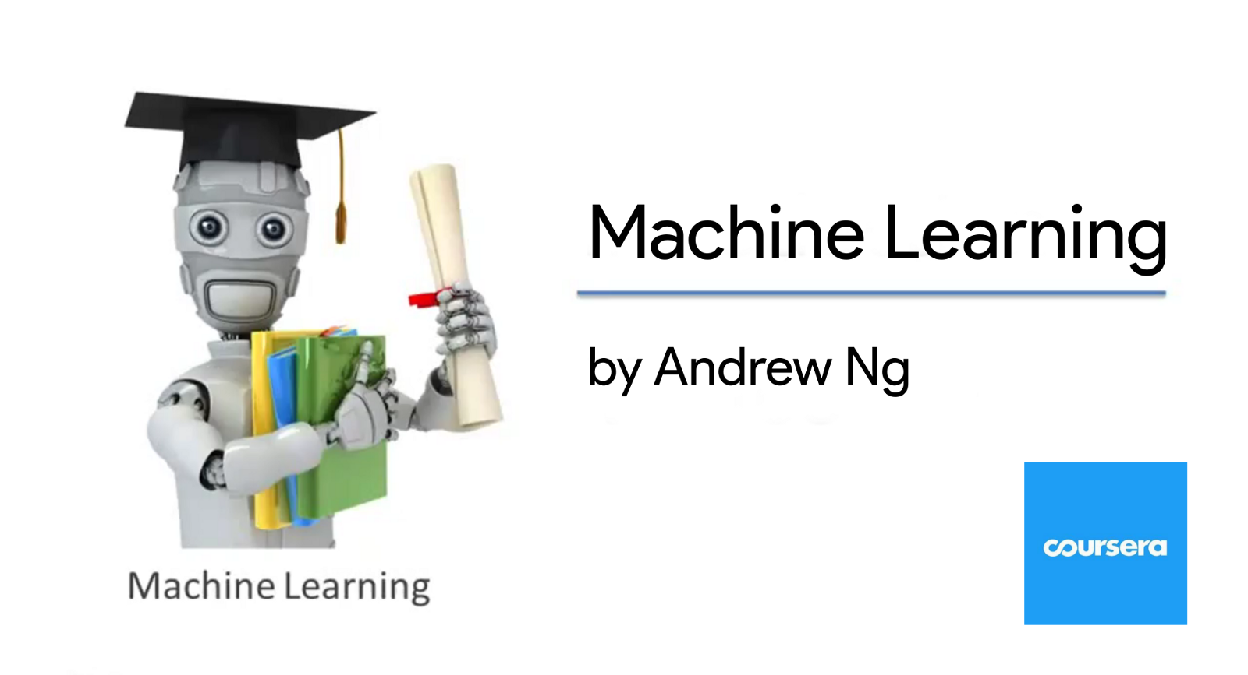
Slides taken from:

Slide 3
Learning Outcomes
Describe Machine Learning
Describe Supervised Machine Learning
Differentiate between Regression and Classification
Describe how line of best fit is established for a univariate regression task
Describe what is classification with reference to use cases
Outline the tasks undertaken to perform task classification
Perform commonly applied exploratory analysis on dataset
Outline the tasks undertaken to perform task classification
List the ways in which text can be transformed to numerical values
Use Python’s scilearn library to transform text to tf-idf scores
Undertake steps outlined to clean text
Split data into train and test using scilearn
Set hyerparameters to the SVM model
Run the test set through model
Interpret performance metrics

Slide 4
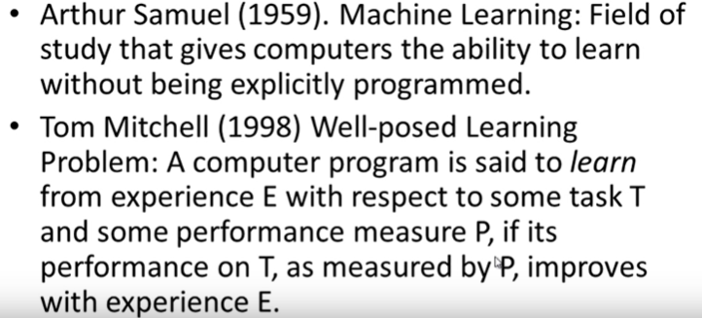
What is Machine Learning ?

Slide 5
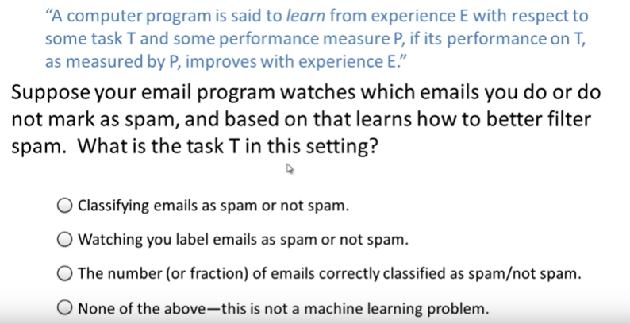
Question

Slide 6
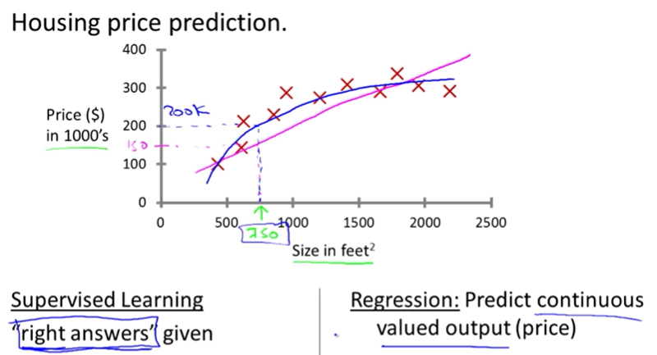
Supervised Machine Learning

Slide 7
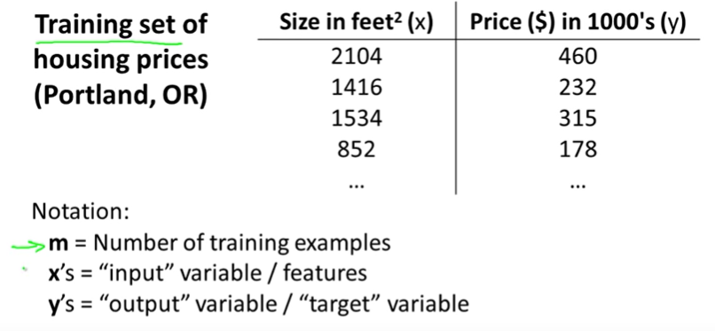
Supervised Machine Learning

Slide 8
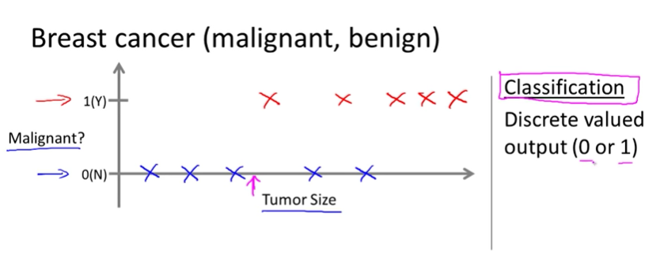
Supervised Machine Learning

Slide 9
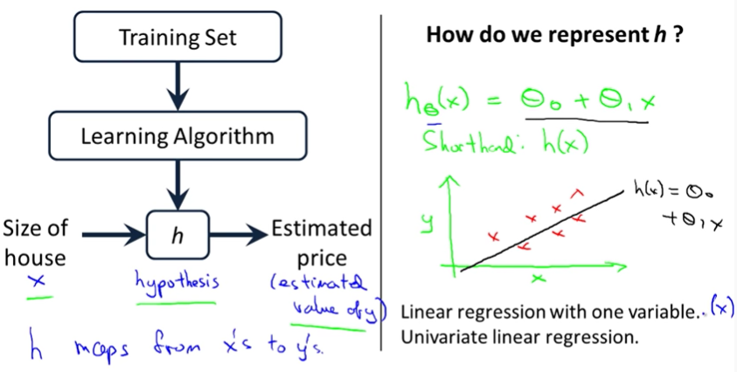
Supervised Machine Learning

Slide 10
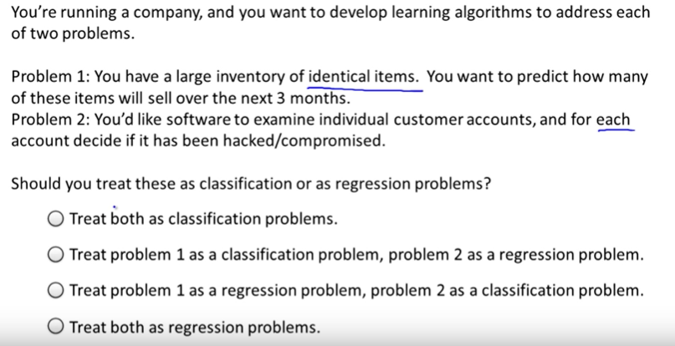
Supervised Machine Learning

Slide 11
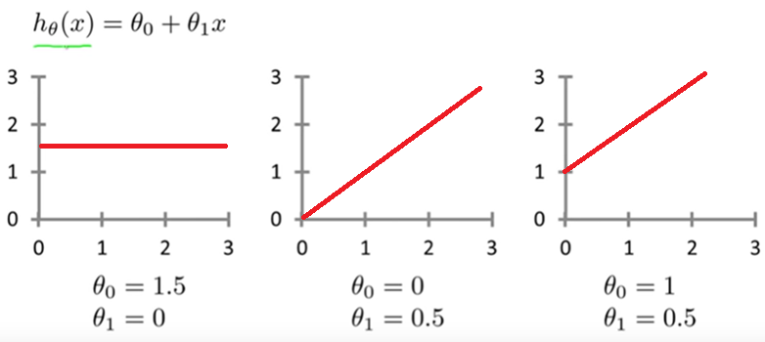
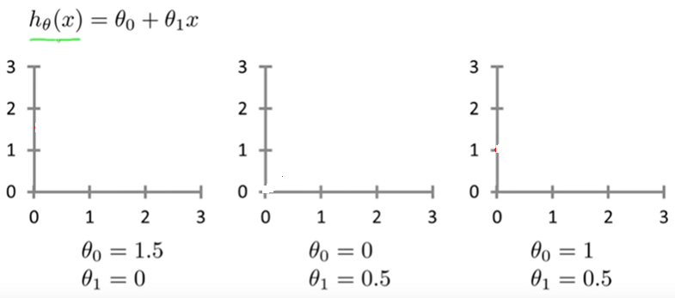
Supervised Machine Learning

Slide 12
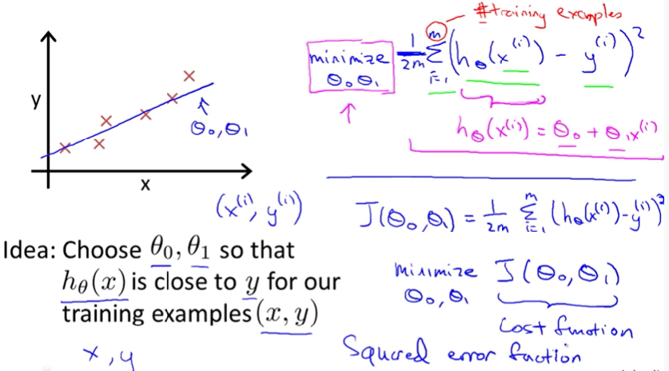
Supervised Machine Learning

Slide 13
Supervised Machine Learning

Slide 14
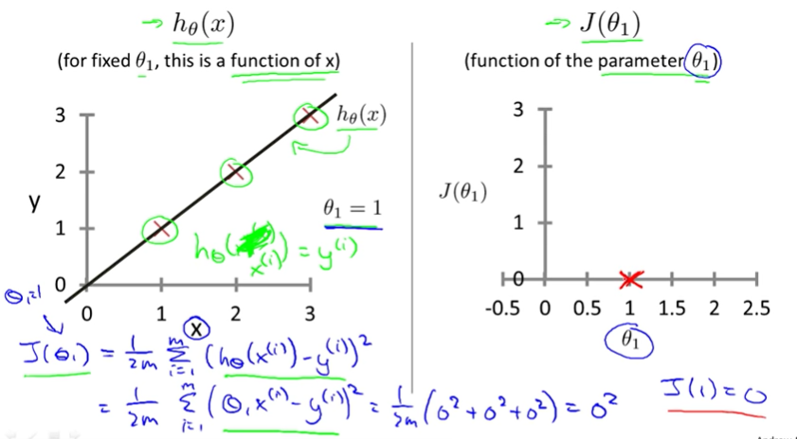
Supervised Machine Learning

Slide 15
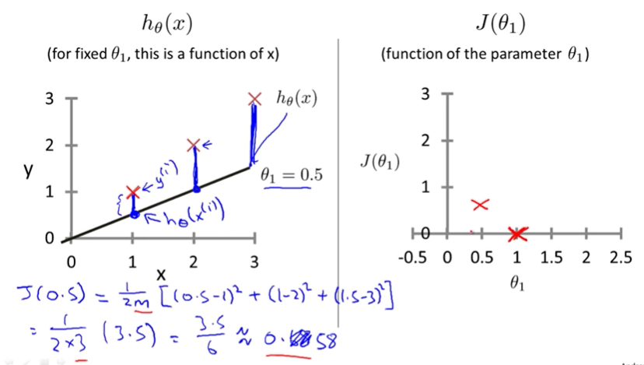
Supervised Machine Learning

Slide 16
Supervised Machine Learning

Slide 17
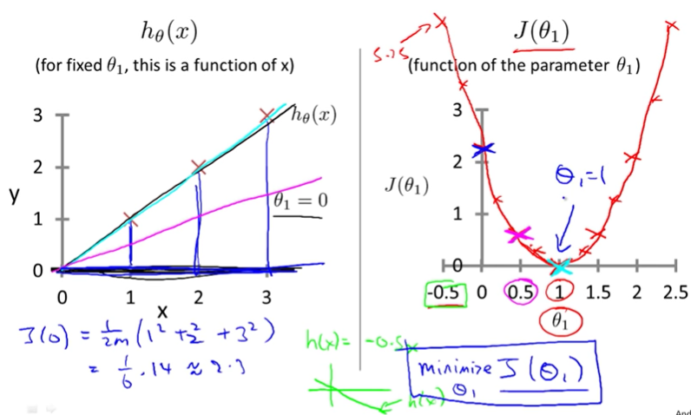
Supervised Machine Learning

